Slide 1
CASPER FFG
-- Lu Yu
The Holcombe Department of Electrical & Computer Engineering

Slide 2
Casper FFG
Casper the Friendly Finality Gadget (FFG)
Vitalik Buterin and Virgil Griffith (2017).
PBFT-based
Simple design but hard proof-of-security
Inherit the code design of PBFT
Add new mechanisms
Simplify several rules

Slide 3
Review PBFT
Permissioned network
Only “permitted” nodes can participate in the consensus process.
Why?
Nodes need to verify each other’s signature.
Keep track of the number of active nodes.
How does Ethereum implement it?
Participants ”register” with their deposits/assets.

Slide 4
Review PBFT
Permissioned network
Only “permitted” nodes can participate in the consensus process.
Why?
Nodes need to verify each other’s signature.
Keep track of the number of active nodes.
Leader-based:
Only the leader/primary can propose the next block

Slide 5
Review PBFT
Communication-based network
Majority consensus is achieved via voting.
PoW achieves consensus by solving a non-deterministic computational puzzle.

Slide 6
Review PBFT
Communication-based network
Majority consensus is achieved via voting.
PoW achieves consensus by solving a non-deterministic computational puzzle.
Safety-over-Liveness:
The protocol guarantees safety (i.e., no fork) regardless of delay of the network.

Slide 7
Permission-less
Ethereum blockchain is a public (i.e., permission-less) system.
Nodes can join and leave freely.

Slide 8
Permission-less
Ethereum blockchain is a public (i.e., permission-less) system.
Nodes can join and leave freely.
How to prevent Byzantine fault (i.e., random behaviors of the nodes)?
Register with the network with their assets/deposits.

Slide 9
Permission-less
Ethereum blockchain is a public (i.e., permission-less) system.
Nodes can join and leave freely.
How to prevent Byzantine fault (i.e., random behaviors of the nodes)?
Register with the network with their assets/deposits.
If a node breaks a rule, it will be subject to economic loss.
A punishment mechanism is need.

Slide 10
Permission-less
Ethereum blockchain is a public (i.e., permission-less) system.
Nodes can join and leave freely.
How to prevent Byzantine fault (i.e., random behaviors of the nodes)?
Register with the network with their assets/deposits.
If a node breaks a rule, it will be subject to economic loss.
A punishment mechanism is need.
So PoS-based consensus can be applied to permission-less system.

Slide 11
Punishment Mechanism
What behaviors should be punished?
Vitalik found that PBFT requires four rules.

Slide 12
Punishment Mechanism
What behaviors should be punished?
Vitalik found that PBFT requires 4 rules.
Minimal Slashing Conditions:
Sending a commit requires seeing 2/3 prepares.

Slide 13
Punishment Mechanism
What behaviors should be punished?
Vitalik found that PBFT requires 4 rules.
Minimal Slashing Conditions:
Sending a commit requires seeing 2/3 prepares.
If you make a prepare in some epoch pointing to some particular previous epoch, then you need to have seen 2/3 prepares in that epoch, and those prepares must point to the same previous epoch.

Slide 14
Punishment Mechanism
What behaviors should be punished?
Vitalik found that PBFT requires 4 rules.
Minimal Slashing Conditions (4):
Sending a commit requires seeing 2/3 prepares.
If you make a prepare in some epoch pointing to some particular previous epoch, then you need to have seen 2/3 prepares in that epoch, and those prepares must point to the same previous epoch.
If you make a commit during some epoch, then you clearly saw 2/3 prepares during that epoch, and so any future prepares that you do should better be referencing that epoch or something newer.

Slide 15
Punishment Mechanism
What behaviors should be punished?
Vitalik found that PBFT requires 4 rules.
Minimal Slashing Conditions (4):
Sending a commit requires seeing 2/3 prepares.
If you make a prepare in some epoch pointing to some particular previous epoch, then you need to have seen 2/3 prepares in that epoch, and those prepares must point to the same previous epoch.
If you make a commit during some epoch, then you clearly saw 2/3 prepares during that epoch, and so any future prepares that you do should better be referencing that epoch or something newer.
You can’t prepare twice in a single epoch.

Slide 16
Punishment Mechanism
Minimal Slashing Conditions (2):
A validator must NOT publish two distinct votes for the same target height.
A validator must NOT vote within the span of its other votes.

Slide 17
Casper FFG
Casper FFG overlays on top of the Ethash.
Ethash is the PoW in Ethereum.
Makes it easier to implement an upgrade on the existing PoW chain.

Slide 18
Casper FFG
Casper FFG overlays on top of the Ethash.
Ethash is the PoW in Ethereum.
Makes it easier to implement an upgrade on the existing PoW chain.
Casper FFG is only responsible for consensus.
A fixed set of validators and a block proposal mechanism (PoW).
Yes! Blocks are still mined via PoW.

Slide 19
Casper FFG
Casper FFG overlays on top of the Ethash.
Ethash is the PoW in Ethereum.
Makes it easier to implement an upgrade on the existing PoW chain.
Casper FFG is only responsible for consensus.
A fixed set of validators and a block proposal mechanism (PoW).
Yes! Blocks are still mined via PoW.
Every 50th block is going to be a PoS checkpoint, where finality is assessed by the validators.
Finality means an operation cannot be reversed once it is done.

Slide 20
Blocks form a tree.
Not a linked list.
49
49
49
49
49
49
49
https://arxiv.org/pdf/1710.09437.pdf

Slide 21
Blocks form a tree.
Not a linked list.
The genesis block is called the root of the tree.
49
49
49
49
49
49
49
https://arxiv.org/pdf/1710.09437.pdf

Slide 22
Blocks form a tree.
Not a linked list.
The genesis block is called the root of the tree.
Every block whose height is an exact multiple of 50 is a checkpoint.
49
49
49
49
49
49
49
https://arxiv.org/pdf/1710.09437.pdf

Slide 23
Blocks form a tree.
Not a linked list.
The genesis block is called the root of the tree.
Every block whose height is an exact multiple of 50 is a checkpoint.
(Efficiency) Validators work on the subtree of checkpoints.
49
49
49
49
49
49
49
https://arxiv.org/pdf/1710.09437.pdf

Slide 24
Blocks form a tree.
Not a linked list.
The genesis block is called the root of the tree.
Every block whose height is an exact multiple of 50 is a checkpoint.
(Efficiency) Validators work on the subtree of checkpoints.
A vote contains a link consisting of two checkpoints
L= src->target.
Broadcast and collect.
49
49
49
49
49
49
49
https://arxiv.org/pdf/1710.09437.pdf

Slide 25
Supermajority Link
If the sum of the deposits of the nodes voting for a link L exceeds 2/3 of the total deposit, L is called the supermajority link.

Slide 26
For example, three distinct supermajority links, which is represented byr->b1, b1->b2, b2->b3 respectively.
h(b₃) > h(b₂)+1
Source and target must be in the same branch; otherwise, the two nodes are called conflicting.

Slide 27
Supermajority Link
If the sum of the deposits of the nodes voting for a link L exceeds 2/3 of the total deposit, L is called the supermajority link.
The source of a supermajority link is justified and the target is finalized.
The root node is justified and finalized by default.
After two rounds of voting, each checkpoint is justified (prepared) and then finalized (committed).

Slide 28
For example, three distinct supermajority links, which is represented byr->b1, b1->b2, b2->b3 respectively.
h(b₃) > h(b₂)+1
Source and target must be in the same branch; otherwise, the two nodes are called conflicting.
r, b1, and b2 are finalized.
b3 is justified.

Slide 29
Checkpoint Selection
Fork Choice Rule:
Select the highest “justified” checkpoint to establish the link.

Slide 30
Checkpoint Selection
Fork Choice Rule:
Select the highest “justified” checkpoint to establish the link.
Validator set change dynamically.

Slide 31
Checkpoint Selection
Fork Choice Rule:
Select the highest “justified” checkpoint to establish the link.
Validator set change dynamically.
Withdraw delay:
A node needs to wait a certain amount of time, from exiting the network to getting the deposit back.

Slide 32
Checkpoint Selection
Fork Choice Rule:
Select the highest “justified” checkpoint to establish the link.
Validator set change dynamically.
Withdraw delay:
A node needs to wait a certain amont of time, from exiting the network to getting the deposit back.
Dynasty of a checkpoint:
The number of checkpoints from the root node to that node.

Slide 33
For example, three distinct supermajority links, which is represented byr->b1, b1->b2, b2->b3 respectively.
h(b₃) > h(b₂)+1
Source and target must be in the same branch; otherwise, the two nodes are called conflicting.
r, b1, and b2 are finalized.
b3 is justified.
The dynasty of b3 is 3.

Slide 34
Checkpoint Selection
Forward validator set of a dynasty
Nodes that joined by that dynasty.

Slide 35
Checkpoint Selection
Forward validator set of a dynasty
Nodes that joined by that dynasty.
Rear validator set of a dynasty
Nodes that existed by that dynasty.

Slide 36
Checkpoint Selection
Forward validator set of a dynasty
Nodes that joined by that dynasty.
Rear validator set of a dynasty
Nodes that existed by that dynasty.
The forward validator set and rear validator set of a dynasty are usually highly overlapped.

Slide 37
Checkpoint Selection
Forward validator set of a dynasty
Nodes that joined by that dynasty.
Rear validator set of a dynasty
Nodes that existed by that dynasty.
The forward validator set and rear validator set of a dynasty are usually highly overlapped.
What might happen if the two sets substantially differ?

Slide 38
Nodes collude to join/leave the network together.
Safety failure may occur when two grandchildren of a finalized checkpoint have different dynasties because the evidence was included in one chain but not the other.
Attack from dynamic validator sets

Slide 39
Improvements of Casper FFG
Economic Punishment:
PBFT applies to permissioned system.
Casper FFG is permission-less.

Slide 40
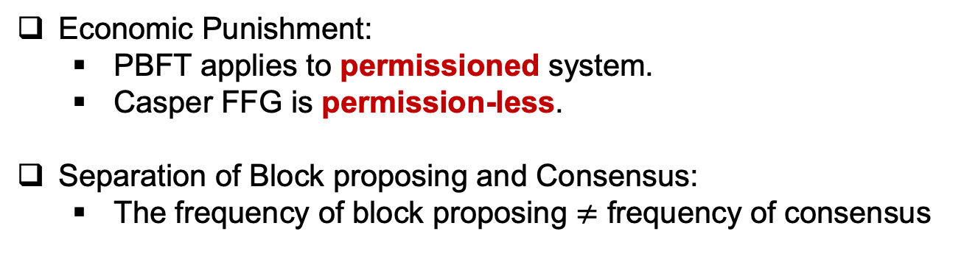
Improvements of Casper FFG
Economic Punishment:
PBFT applies to permissioned system.
Casper FFG is permission-less.
Separation of Block proposing and Consensus:
The frequency of block proposing $≠$ frequency of consensus

Slide 41
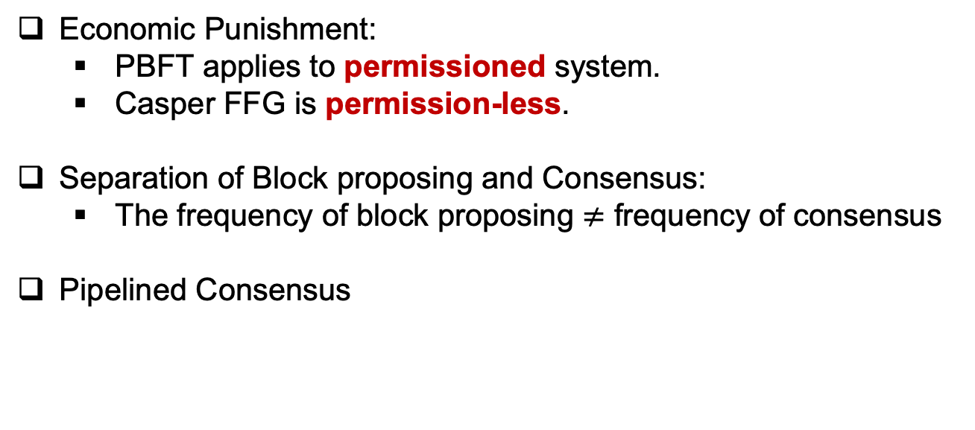
Improvements of Casper FFG
Economic Punishment:
PBFT applies to permissioned system.
Casper FFG is permission-less.
Separation of Block proposing and Consensus:
The frequency of block proposing $≠$ frequency of consensus
Pipelined Consensus

Slide 42
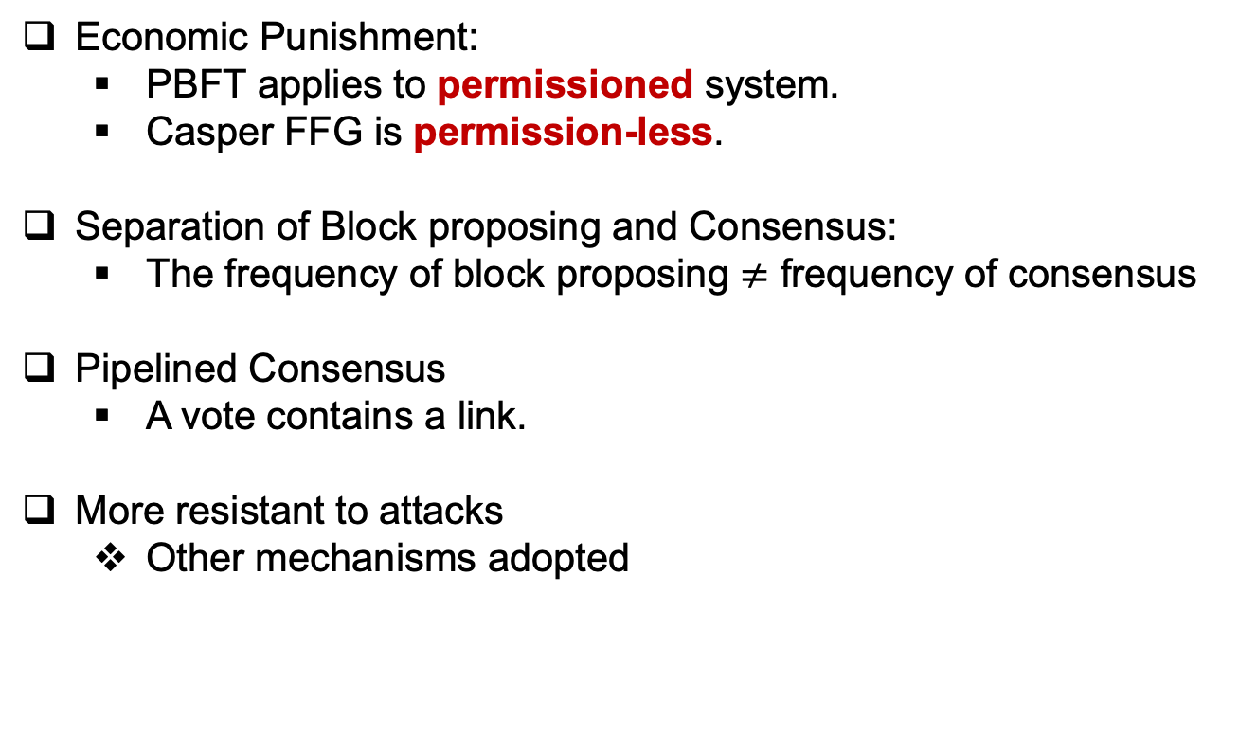
Improvements of Casper FFG
Economic Punishment:
PBFT applies to permissioned system.
Casper FFG is permission-less.
Separation of Block proposing and Consensus:
The frequency of block proposing $≠$ frequency of consensus
Pipelined Consensus
A vote contains a link.
More resistant to attacks
Other mechanisms adopted

Slide 43
Reference
Ethereum Wiki, “Proof of Stake FAQs”. Available at: https://eth.wiki/en/concepts/proof-of-stake-faqs
https://blog.cosmos.network/consensus-compare-casper-vs-tendermint-6df154ad56ae
Juin Chiu, “Casper FFG: Consensus Protocol for the Realization of Proof-of-Stake”. Available at: https://medium.com/unitychain/intro-to-casper-ffg-9ed944d98b2d
Juin Chiu, “Introduction to PBFT”. Available at: https://medium.com/unitychain/if-you-really-want-to-make-sense-of-blockchain-you-cannot-ignore-the-classics-an-introduction-to-3c72dc8c5515

